Slide 1


Customized Optimizing McDonald’s meal
Programming project
for Advance Programming Spring 2022
Jiaming Huang
Ting Yang
Manunpat Sirijaturaporn

Slide 2
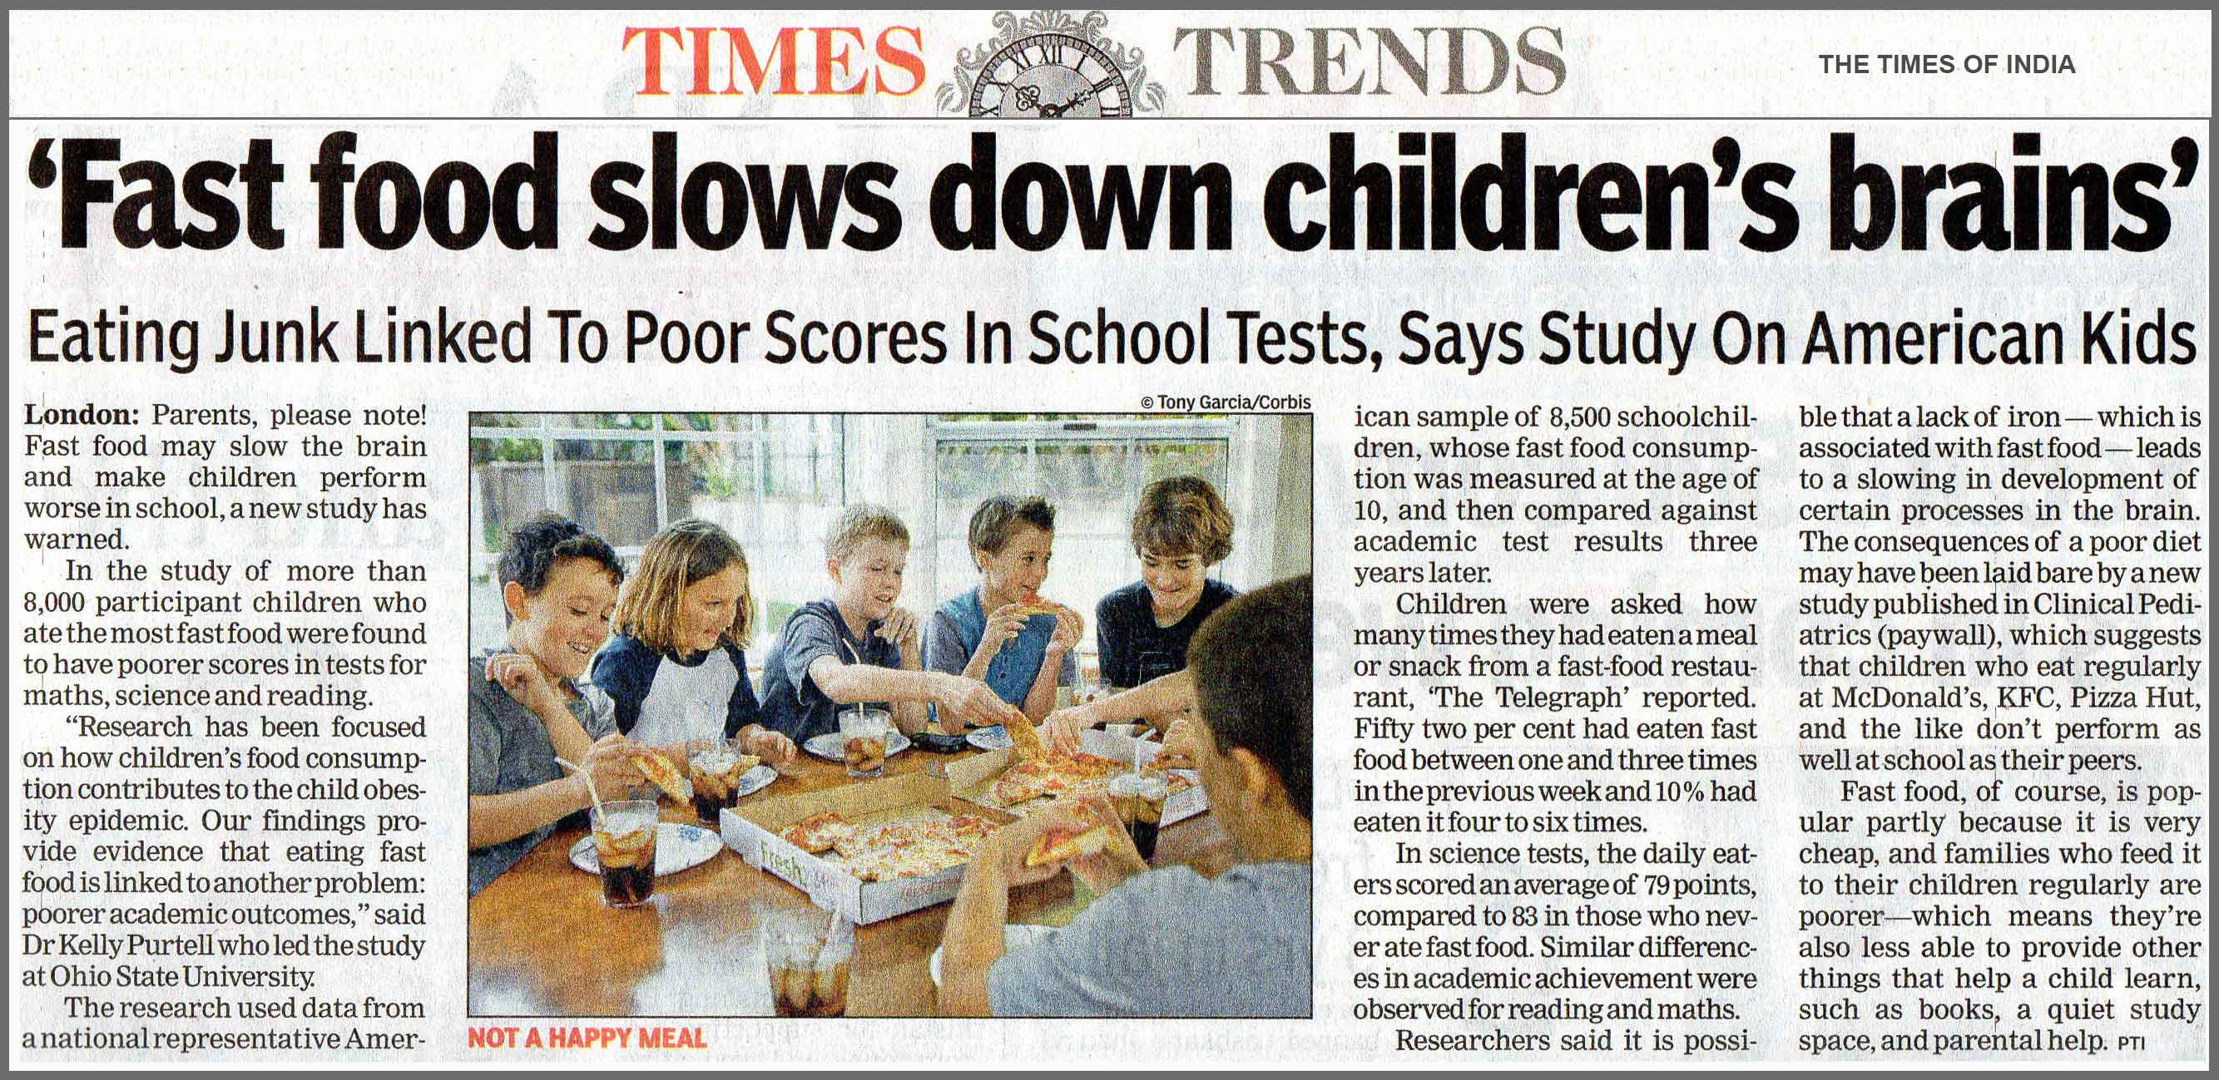
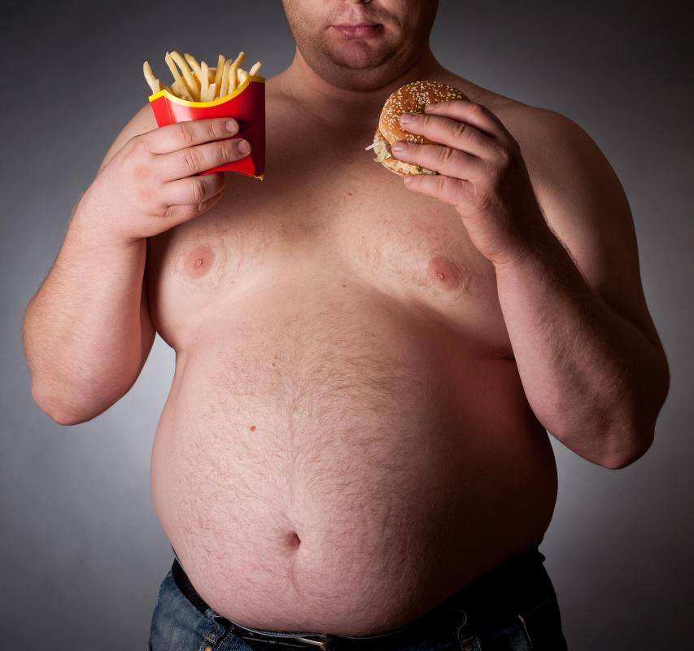
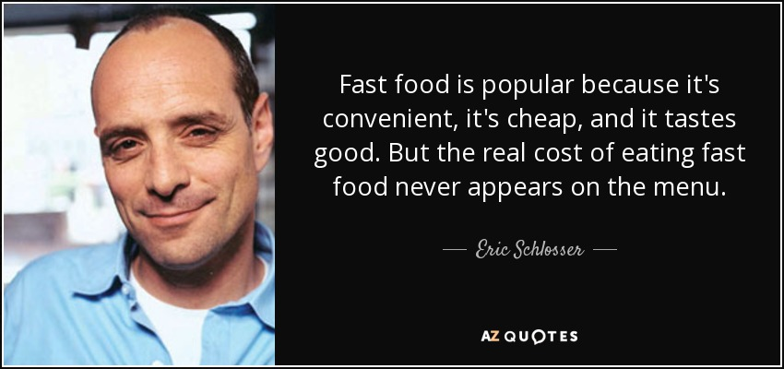
Motivation and Objective
“We aim to optimize McDonald’s intake given the minimum daily nutrition requirement”
Notes:
Motivation and Objective
Consuming food is one of the methods to relieve and take a break from the rush and pressure of modern life. Although healthy food has become an unstoppable trend, the popularity of fast food still remains because it perfectly matches the urban lifestyle.
For some working people, they may have no choice to eating at Mcdonal’s frequently due to fast work pace
Speaking of fast food, McDonald’s always holds a top rank position due to its long and successful history. McDonald’s is the world’s leading global food service retailer with over 38,000 locations in over 100 countries. However, McDonald's has left a very unhealthy image in the public, but in recent years even in the fitness groups, there are researches that McDonald's food is useful to help fitness people recover or lose weight. The book “My MacDonald’s Diet” illustrates how the author only eat MacDonald’s within 6 month and he is lighter and healthier as he nears the end of his unconventional weight-loss plan.
So in our research and programming, we try to provide our customers with a healthy McDonald's dining structure that suits them as much as possible. -> new trend about healthy fast food
Our study aims to optimize McDonald’s intake given the minimum daily nutrition requirement, assuming users consume McDonald’s 3 meals a day. McDonald’s menu would be analyzed by user individual profiles to provide the optimal consumption suggestions regarding suitable calories and nutrients per day.

Slide 3
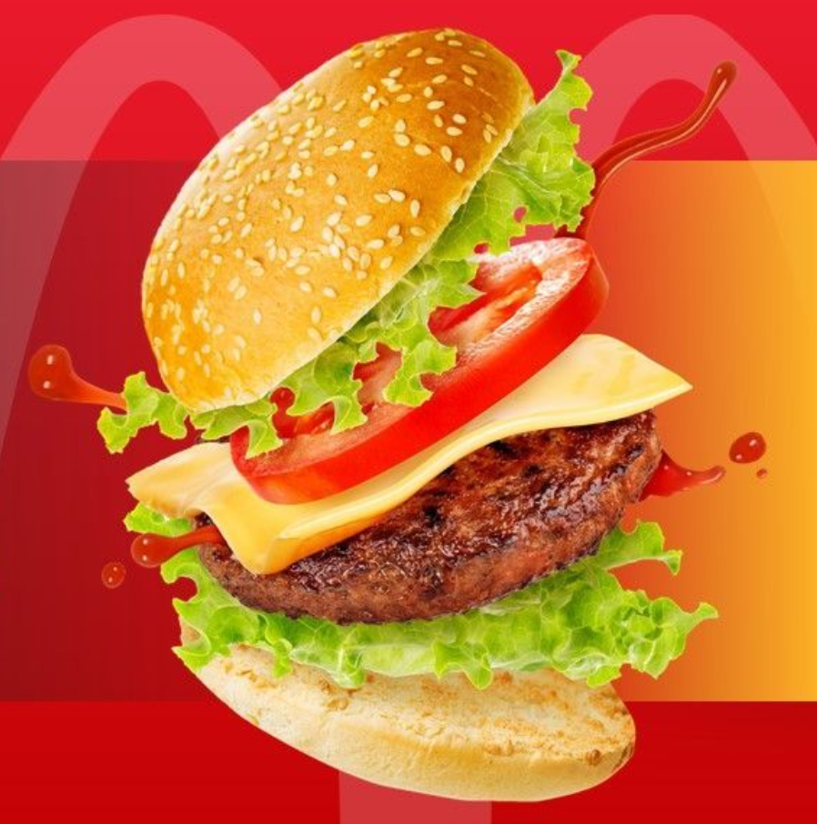

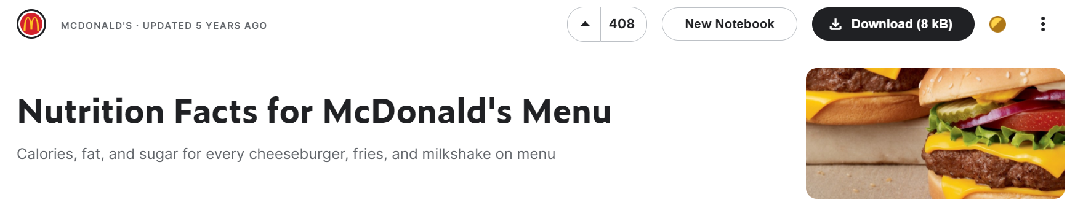
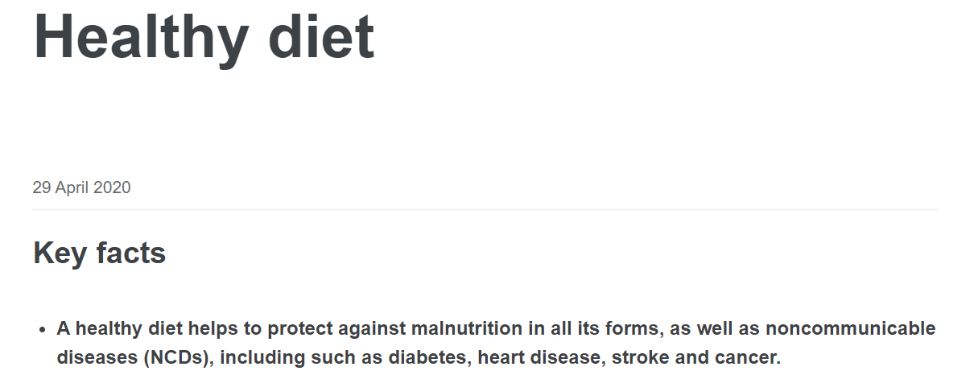

Data preparation
Reference: https://www.kaggle.com/datasets/mcdonalds/nutrition-facts, https://www.who.int/news-room/fact-sheets/detail/healthy-diet
Notes:
Data preparation:
McDonald’s menu
nutrition constraint setting (....what nutrition)
nutrition constraint selecting reference ( why we select those of nutrition as the constraint)

Slide 4
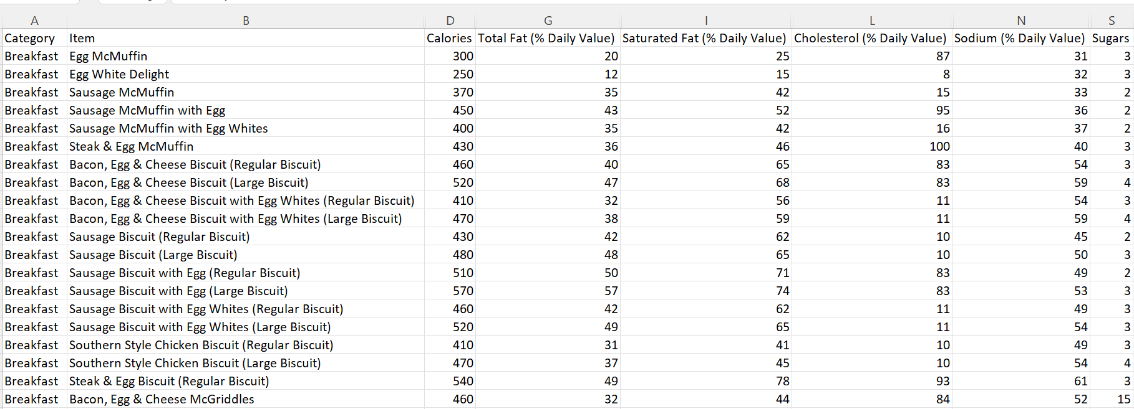

Data preparation
Notes:
Data preparation:
McDonald’s menu
nutrition constraint setting (....what nutrition)
nutrition constraint selecting reference ( why we select those of nutrition as the constraint)

Slide 5
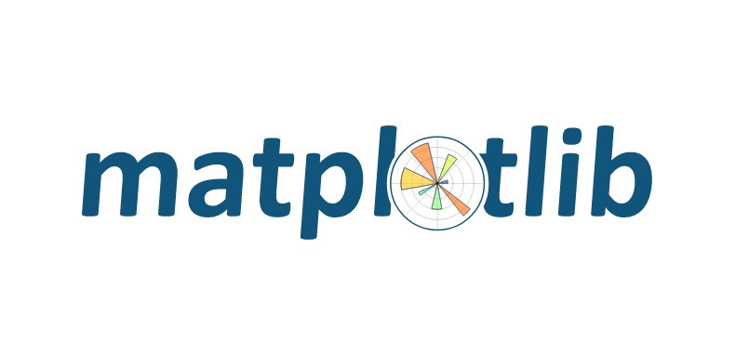






Package preparation
Plotting nutrition each meal
Optimization problem
Interface and visualization
Notes:
Package preparation:
Google OR tools - (specific name: ortools.linear_solver), pandas, numpy for setting optimization problem
matplotlib: for plotting
tkinter: it is a form of user interface which allows users to interact with computers through visual indicators using items such as icons, menus, windows, etc. so, it seem to be suitable to build our application
ttk bootstrap: for beautifying interface layout/color
Python Imaging Library (PIL): for inserting image

Slide 6
Output
Notes:
output:
in this project, our output will be a application where users can input their personal information and then obtain recommended diet combinations for every three meals at McDonald's within the calorie limit

